Slide 1

^{Chapter 1} Introducing Data Structures and Algorithms
Royal University of Phnom Penh
Faculty of Engineering
Data Structures and Algorithms
Dr. Srun Sovila

Slide 2
Outline
Arrays
Ordered Arrays
The Bubble Sort
The Insertion Sort

Slide 3
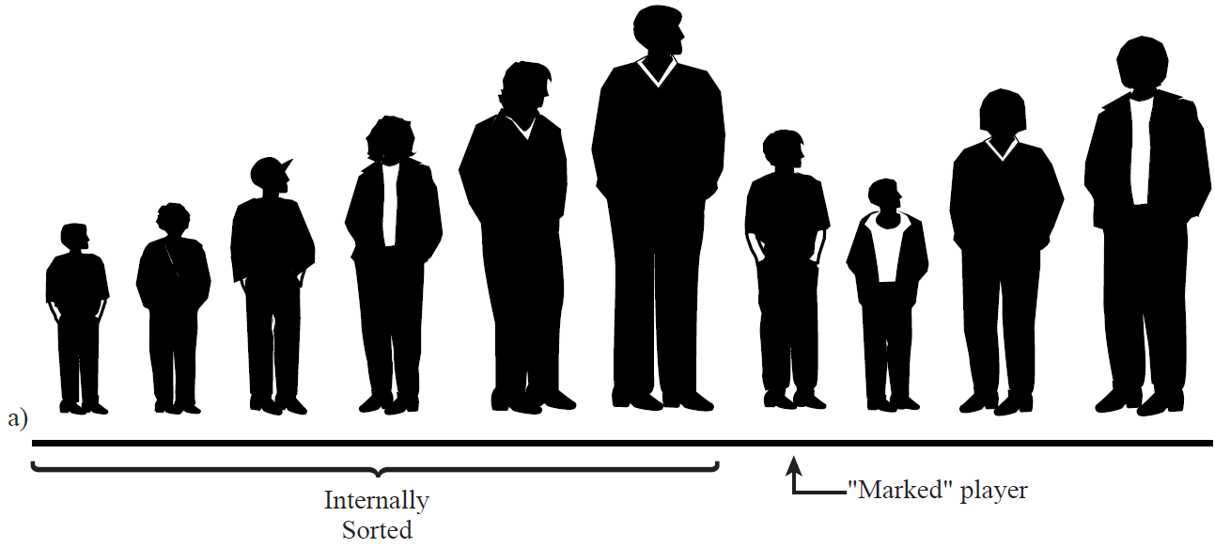
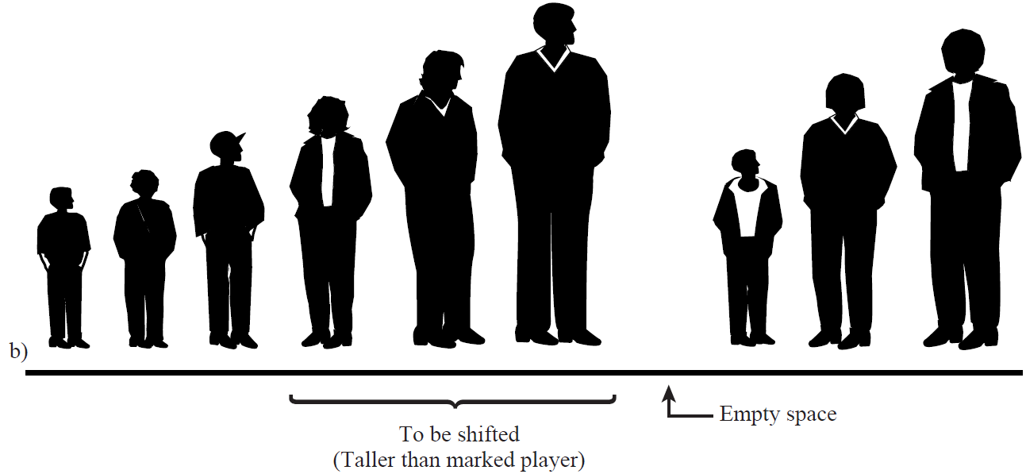
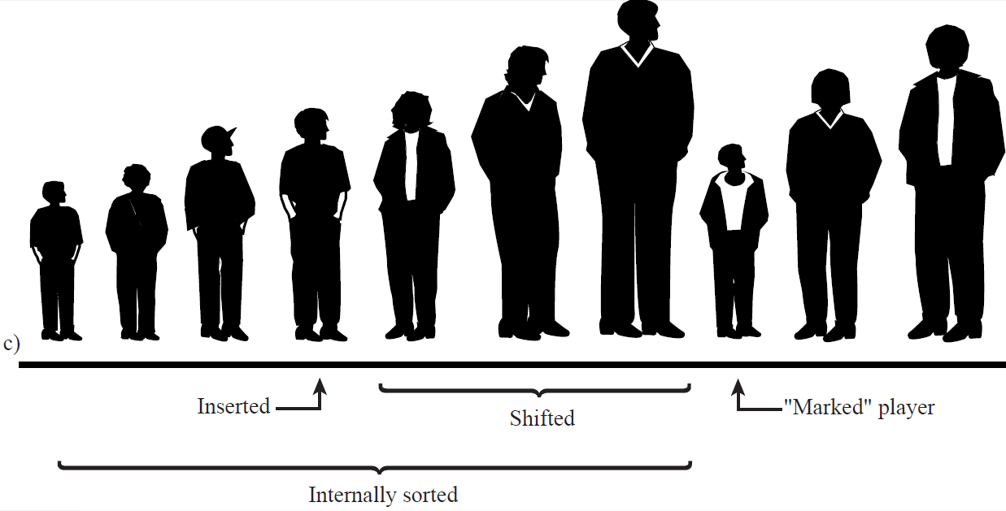
Insertion Sort: How Does It Work?
Marked player and take it out;
Find position for the marked player (by move the taller to right);
Insert the marked player to the found position;
Go to 1st point, until the end of right (last player).

Slide 4
Insertion Sort: Code in C/C++
for( i=1; i<nElems; i++){ //marked i^{th} element or divided by i
tmp = arr[ i ]; //remove marked item
j = i; //Start shifts at ith
while( j>0 && arr[ j-1 ]>=tmp ){
arr[ j ] = arr[ j-1 ]; //Otherwise, shift item to right
--j; //Go left one position
}
arr[ j ] = tmp; //insert marked item
}
Insertion Animations:
http://cathyatseneca.github.io/DSAnim/web/insertion.html
http://www.ee.ryerson.ca/~courses/coe428/sorting/insertionsort.html

Slide 5
Insertion Sort: Efficiency
If n – number of items in the array
How many comparisons does it require?
For the 1st pass there is 1 comparison, 2nd pass there are 2 comparisons (maximum), and so on up to maximum (n-1)
Thus, total of comparisons is:
1 + 2 + 3 +…+ (n-1) = n*(n-1)/2
So, insertion sort runs in Big-O(n²) time for random data.
In case, the data is almost sorted, what is the run time of Bubble? And Insertion?

Slide 6


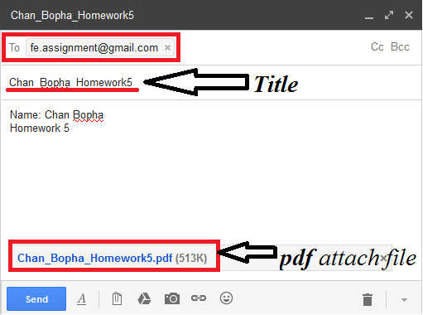
Homework5 submit to: fe.assignment@gmail.com
Thu., 29-Oct.-2015
@ 15:00
Write a function, which will sort data of array by ascending or descending with Insertion sort algorithm (Option ascending or descending will be input by user);
Explain your codes by comments;
Draw flow chart of your source codes.
Please send your homework only to fe.assignment@gmail.com
With title: Your Full Name and Homework# (Example: Chan Bopha Homework 5
Attachment file PDF with Name: YourFullName and Homework# (Chan_Bopha_Homework5.pdf)

Slide 7
End of Chapter 1

